Slide 1


Tree base models
December 2024

Slide 2

Agenda
- Overview of Tree-Based Models
- Key Techniques: Decision Trees, Random Forest, Gradient Boosting
- Practical Applications and Case Studies
- Advantages and Limitations
- Summary and Recommendations

Slide 3
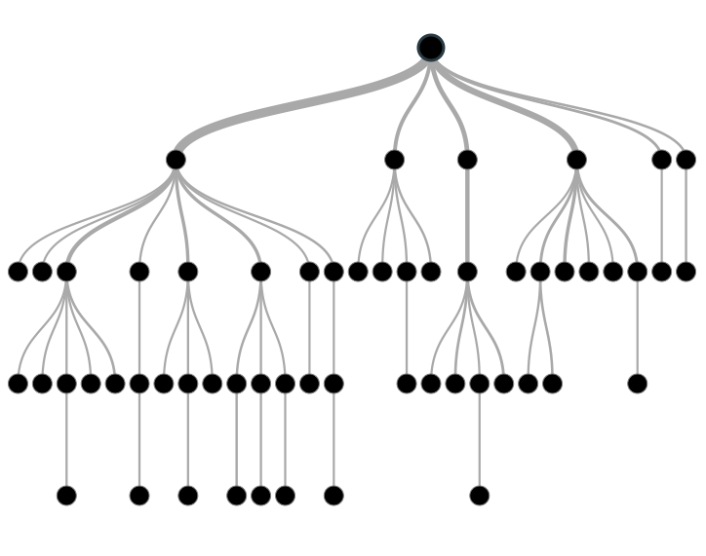
What are Tree-Based Models
Introduction
Definition: Tree-based models are a class of machine learning algorithms that use a tree-like structure for decision-making.
Key Features:
Non-linear data modeling.
Intuitive and interpretable results.
Handle both categorical and continuous variables.

Slide 4
Decision Trees
Introduction :
- Decision Trees are a supervised machine learning algorithm simulating human decision-making.
- They handle categorical data effectively, unlike many other ML algorithms.
- Capable of modeling complex, nonlinear relationships between independent and target variables.
- Popular for their simplicity and clarity, making them easily interpretable for business users.
- The model functions as a tree structure, making predictions based on a series of questions.
- Data is split based on the most important attributes, forming multiway decision trees when divided into multiple partitions.

Slide 5
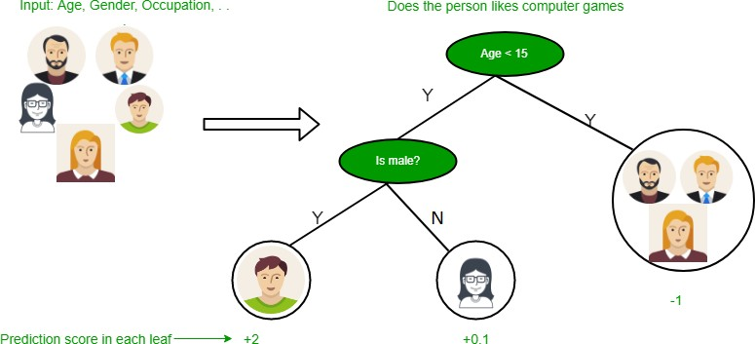
Example of Decision Tree
Here the first split he based on Age, we will discuss further how the split is made on Age

Slide 6
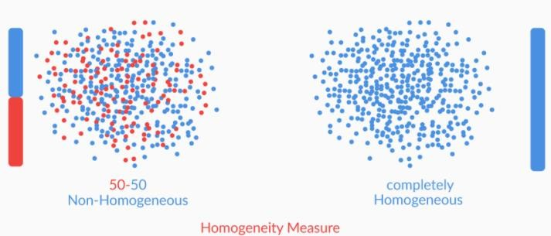
Algorithms of Decision Tree
Homogeneity Measures :
Dataset with 8 Attributes: We have a dataset with 8 attributes for splitting the data.
Selection Criterion: Randomly selecting an attribute to split the data is not ideal.
Homogeneity Measure: The selection criterion is called the Homogeneity Measure, which helps in choosing the best attribute.
Optimal Attribute: We select the attribute that maximizes the Homogeneity Measure.
Goal: The attribute with the highest homogeneity will provide the most meaningful split in the data.

Slide 7
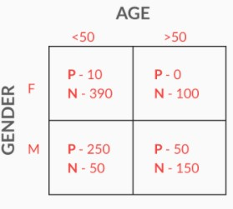
Gini Index
Homogeneity Measure:
Calculated using the Gini Index.
Gini Index indicates impurity:
Gini = 1: High homogeneity (pure).
Gini = 0: Low homogeneity (impure).
Formula for Gini Index:
Gini Index (attribute) = (fraction of group 1) × Gini(group 1) + (fraction of group 2) × Gini(group 2)
Example:
Dataset Split on Gender:
Gini Index (Gender) = (Fraction Male × Gini(Male)) + (Fraction Female × Gini(Female)) = 0.5 × [(1/50 × 2) + (49/50 × 2)] + 0.5 × [(3/5 × 2) + (2/5 × 2)] = 0.74
Dataset Split on Age:
Gini Index (Age) = (Fraction Group 1 × Gini(Group 1)) + (Fraction Group 2 × Gini(Group 2)) = 0.7 × [(26/70 × 2) + (44/70 × 2)] + 0.3 × [(1/6 × 2) + (5/6 × 2)] = 0.59
Conclusion:
Gini Index for Gender = 0.74: Higher impurity (close to 1), suitable for splitting.
Gini Index for Age = 0.59: Lower impurity, less suitable for splitting.
Key Insight:
Choose the attribute with the highest Gini Index (highest homogeneity).

Slide 8
Entropy and Information Gained
Entropy quantifies the degree of disorder in the given data. Entropy ranges from 0 to 1 if Entropy =0 that means data has high Homogeneity
Formula for entropy :
Where pi = Probability of finding label i k = Number of different labels ε[D] = Entropy of Dataset D
Information Gained Measures how much as the entropy decreases after splitting the data Formula for Information Gained
Where ε[D]
ε[DA]
= Entropy of parent set
= Entropy of Partitions Obtained after splitting
ε[DA=i] = Entropy of Partitions where value of attribute A for the data points is i DA=i = Number of points where attribute A is i
K = Number of different labels

Slide 9
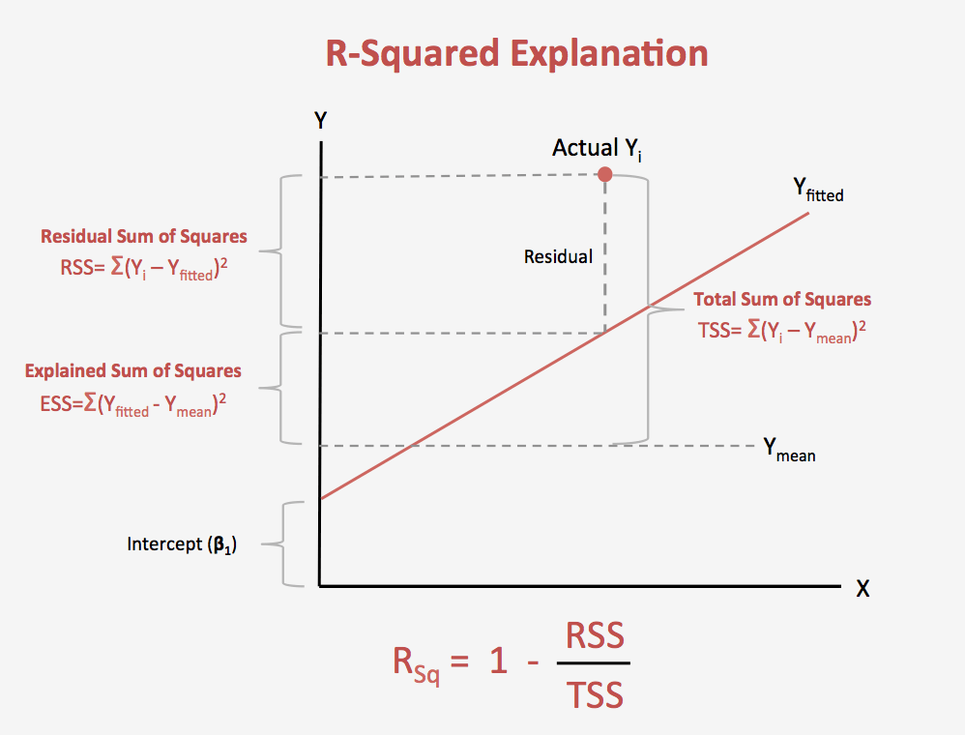
Splitting by R-squared
R-squared is calculated when there are continuous variables in the data.
It is calculated in similar way how we work on a Regression model.
To Split the date R-squared value should be greater than the original data
Formula for R-squared: 1- (RSS/TSS)
Where RSS = Residual Standard Error TSS = Total sum of squares

Slide 10
Hyperparameters of Decision Tree
Scikit-learn provides some functionalities or parameters that are to be used with a Decision Tree classifier to enhance the model’s accuracy in accordance with the given data.
criterion: This parameter is used to measure the quality of the split. The default value for this parameter is set to “Gini”. If you want the measure to be calculated by entropy gain, you can change this parameter to “entropy”.
splitter: This parameter is used to choose the split at each node. If you want the sub-trees to have the best split, you can set this parameter to “best”. We can also have a random split for which the value “random” is set.
max-depth: This is an integer parameter through which we can limit the depth of the tree. The default value for this parameter is set to None.
min_samples_split: This parameter is used to define the minimum number of samples required to split an internal node.
max_leaf_nodes: The default value of max_leaf_nodes is set to None. This parameter is used to grow a tree with max_leaf_nodes in best-first fashion.

Slide 11
Impact of Hyperparameters in Decision Trees
2. min_samples_split
min_samples_split controls the minimum number of samples required to split an internal node.
Increasing min_samples_split:
Pros: Helps in reducing overfitting by ensuring splits only occur when there are enough samples.
Cons: May underfit the data if set too high, ignoring meaningful splits.
Example:
min_samples_split = 2: Allows very fine splits, potentially overfitting.
min_samples_split = 10: More generalization, but may miss finer patterns.
1. max_depth: it controls the maximum depth of the tree.
Increasing depth:
Pros: Captures more patterns in the data.
Cons: Risk of overfitting, capturing noise.
Example:
- Depth 3: Balanced accuracy.
- Depth 10: Overfits, lower validation accuracy.
3. min_samples_leaf
min_samples_leaf specifies the minimum number of samples required to be in a leaf node.
Increasing min_samples_leaf:
Pros: Reduces overfitting by making sure each leaf has sufficient samples, thus promoting generalization.
Cons: Can lead to underfitting if set too high by ignoring small but important patterns.
Example:
min_samples_leaf = 1: Risk of overfitting with too many small leaf nodes.
min_samples_leaf = 5: Helps in reducing overfitting, but might generalize too much.

Slide 12
4. max_features
max_features controls the number of features to consider when looking for the best split.
Increasing max_features:
Pros: Helps the model to find the best possible split, improving accuracy.
Cons: Can increase the risk of overfitting by making the tree more complex.
Example:
max_features = 3: Limits the search space, may reduce overfitting but lower accuracy.
max_features = 8: Allows for a broader search, improving accuracy but increasing the risk of overfitting.
5. max_leaf_nodes
max_leaf_nodes limits the maximum number of leaf nodes in the tree.
Increasing max_leaf_nodes:
Pros: Can help to make the tree more interpretable and avoid excessive complexity.
Cons: Larger values may lead to overfitting if the tree becomes too complex for the data.
Example:
max_leaf_nodes = 10: Limits the tree size, good for generalization.
max_leaf_nodes = 50: Allows the model to grow more complex, but may lead to overfitting.
6. criterion (Gini Impurity / Entropy)
criterion is the function used to measure the quality of a split.
Changing criterion:
Gini Impurity: Faster to compute, works well for binary classification.
Entropy: Measures information gain, works well in multi-class classification tasks.
Example:
criterion = Gini: Generally faster and works well for classification tasks.
criterion = Entropy: Provides more detailed splits, but computationally heavier.

Slide 13
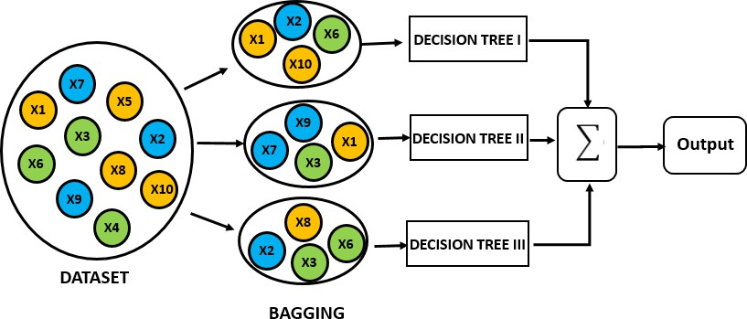
Random Forest
To start learning about Random Forest, we should first know about the Ensembles.
Ensembles :
It means group of things viewed as whole rather than individually. They use a group of models to make prediction, unlike Decision Tree. Random forest is the most popular ensemble technique. Ensemble made by combinations of large number of decision trees. In Random forest Bagging technique is used which is a Ensemble method. Lets see the figure below how its work.

Slide 14
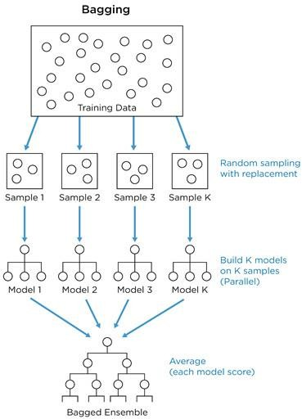
Creating Random Forest
Random Forest:
Shares similar hyperparameters with Decision Trees.
Consists of a collection of Decision Trees.
Created using bagging (bootstrapped aggregation), an ensemble technique.
Bagging in Random Forest:
Random samples are selected (bootstrap samples) from the dataset.
Each set of samples is used to train individual trees in the forest.
Flow of Random Forest:
Random bootstrap samples are taken from the training data.
Each sample contains 30-70% of the dataset.
Decision Trees are built on these bootstrap samples.
Final prediction is made by taking the majority vote of all tree predictions.

Slide 15
OOB(out-of-Bag) Error
OOB Error (Out-of-Bag Error):
Equivalent to cross-validation error.
Calculated using training data points as test points.
Bootstrap Sampling:
During sampling, some data points are excluded (unseen) for certain trees in the forest.
These unseen data points are used to estimate OOB error.
Example:
Dataset: 200 data points.
Random Forest: 40 decision trees, each trained on 25 data points.
For a data point "i":
Excluded from 15 trees (unseen).
Of these 15 trees:
10 predict the label as 0.
5 predict the label as 1.
Final prediction: 0 (majority vote).
OOB Error Calculation:
Proportion of data points predicted incorrectly by the ensemble to the total number of data points.

Slide 16
Hyperparameters of Random Forest
1. max_depth: The max_depth of a tree in Random Forest is defined as the longest path between the root node and the leaf node.
2. min_sample_split: Parameter that tells the decision tree in a random forest the minimum required number of observations in any given node to split it. Default = 2
3. max_leaf_nodes: This hyperparameter sets a condition on the splitting of the nodes in the tree and hence restricts the growth of the tree.
4. min_samples_leaf: This Random Forest hyperparameter specifies the minimum number of samples that should be present in the leaf node after splitting a node. Default = 1
5. n_estimators: Number of trees in the forest.
6. max_sample: The max_samples hyperparameter determines what fraction of the original dataset is given to any individual tree.
7. max_features: This resembles the number of maximum features provided to each tree in a random forest.
8. bootstrap: Method for sampling data points (with or without replacement). Default = True
9. criterion: The function to measure the quality of a split. Supported criteria are “gini” for the Gini impurity and “entropy” for the information gain.

Slide 17
Impact of Hyperparameters in Random Forests
1. n_estimators
n_estimators determines the number of trees in the random forest.
Increasing the number of trees:
Pros: Improves stability and accuracy by reducing variance and making the model more robust.
Cons: Higher computational cost and potentially diminishing returns after a certain point.
Example:
50 trees: Good balance between accuracy and computational cost.
200 trees: Marginal improvement in accuracy, but significantly higher cost.
2. max_features
max_features specifies the maximum number of features to consider for each split in a tree.
Increasing max_features:
Pros: More flexibility in finding the best split, improving accuracy.
Cons: May lead to overfitting and increased computational complexity.
Example:
max_features = 5: Reduces overfitting risk, but limits accuracy.
max_features = 8: Increases accuracy, but higher risk of overfitting.
3. max_depth
max_depth controls the maximum depth of each tree in the forest.
Increasing max_depth:
Pros: Captures more complexity in the data, increasing accuracy.
Cons: Risk of overfitting, especially if the trees grow too deep.
Example:
max_depth = 5: Shallow trees with risk of underfitting.
max_depth = 20: Deeper trees, higher accuracy, but possible overfitting.

Slide 18
4. min_samples_split
min_samples_split determines the minimum number of samples required to split an internal node.
Increasing min_samples_split:
Pros: Helps to avoid overfitting by forcing splits only when there are enough samples.
Cons: May lead to underfitting if set too high, missing meaningful splits.
Example:
min_samples_split = 2: Allows more splits, but may lead to overfitting.
min_samples_split = 10: Reduces overfitting but may ignore important patterns.
5. min_samples_leaf
min_samples_leaf specifies the minimum number of samples required to be in a leaf node.
Increasing min_samples_leaf:
Pros: Promotes generalization by reducing the tree's complexity.
Cons: Can lead to underfitting if set too high.
Example:
min_samples_leaf = 1: Risk of overfitting with small leaf nodes.
min_samples_leaf = 5: Helps reduce overfitting, but may generalize too much.

Slide 19
Advantages of Random Forest
Can Parallelize the training of forest, because each tree is constructed independently.
Random forest is more stable than a single decision tree,
Random forest is immune to the curse of dimensionality.
We can calculate OOB error using training data, which gives a correct view of random forest on unseen data.

Slide 20
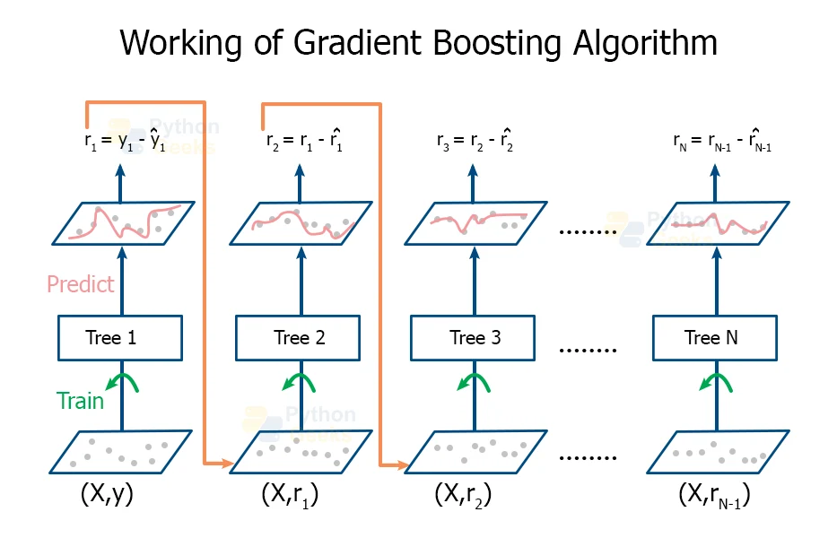
Gradient Boosting - Basic Concept
*Example*: Predicting whether a person buys a product based on income and age.
Show a simple decision tree diagram with splitting nodes based on income, age, and purchase decision at the leaf nodes.
l
What is Gradient Boosting?
An ensemble method that builds trees sequentially, where each new tree corrects the errors made by the previous trees.
Unlike random forests, gradient boosting focuses on minimizing the errors (residuals) of previous predictions.
Key Algorithms:
XGBoost
LightGBM
CatBoost
How it works:
Train a base model (tree) on the residuals from the previous model.
Repeat until the model reaches a certain number of iterations or error threshold.

Slide 21
Adaboost
- AdaBoost is an advanced ensemble learning model that uses a boosting algorithm to improve performance by iteratively training weak classifiers on different subsets of training data.
- It assigns higher weights to misclassified samples in each iteration, allowing subsequent classifiers to focus on challenging examples.
- The main goal of AdaBoost is to reduce error by combining multiple weak models into a single strong model.

Slide 22
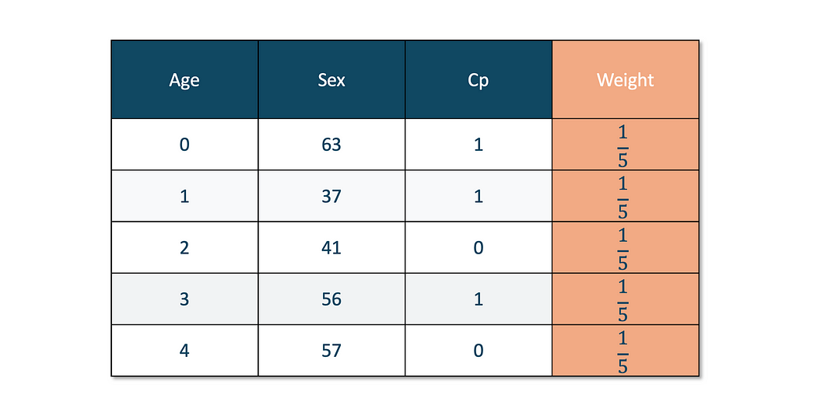
How Does The AdaBoost Work?
We can understand the working of the AdaBoost algorithm in step by step manner as going deep into the work, we can see there are multiple basic steps which this algorithm follows. Let’s take a look at these steps.
Initially, the algorithm starts with taking all the observations and giving them equal weights.
Here, equal weights are given for each of the observations. 1/5 because we have five observations. and the equal value will be 1/5 for each of them.

Slide 23
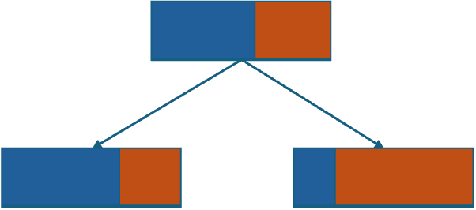
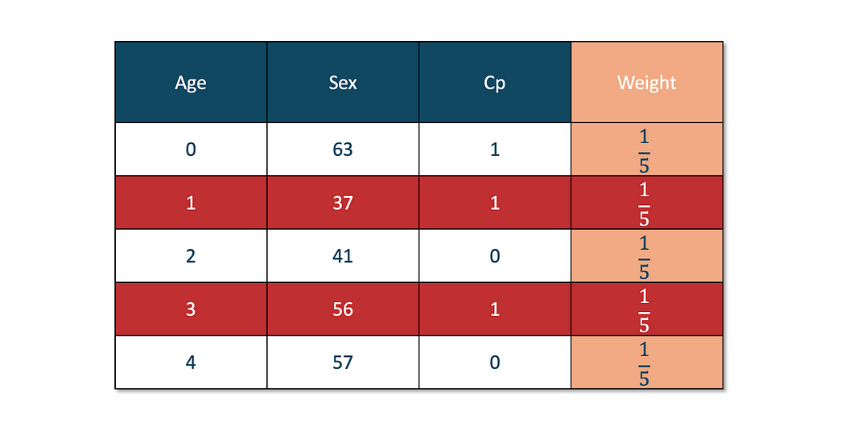
2. We create our first weak learner using a Decision Tree. In AdaBoost, a decision tree with a depth of 1 is used.
Here, a decision stump is created for each feature — age, sex, cp — and then, based on the value of the criterion(entropy, gini, mean absolute error, etc.), we will choose our first decision stump.
3. At this step, we calculate the Total Error and Performance of the stump.
This decision tree with depth 1 is called Decision Stump.

Slide 24
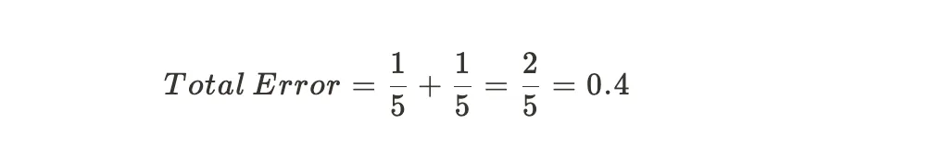
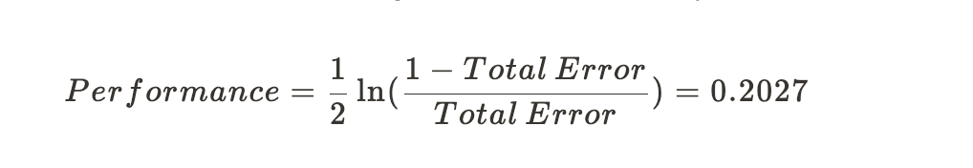
If the red-colored observations are incorrectly predicted by our base learner, then our total error will be:
Now, the Performance (also denoted as α(alpha)) of the stump is calculated by:
After putting the value of Total Error, we get the Performance value of 0.2027.
4. Now, we update the weight of each of the observations.In order to update the weight, we use two different formulas: one for correctly predicted observation and one for incorrectly predicted observation.
Updated weight for:
Incorrectly predicted observation

Slide 25
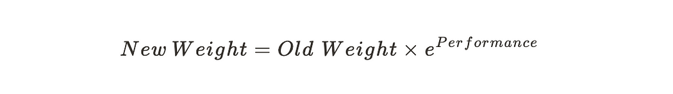
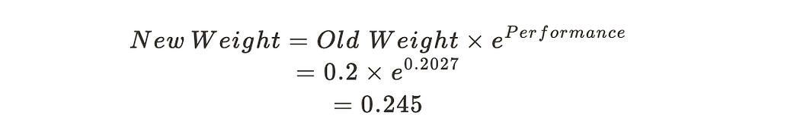
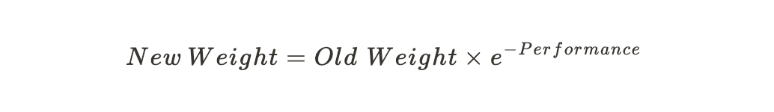
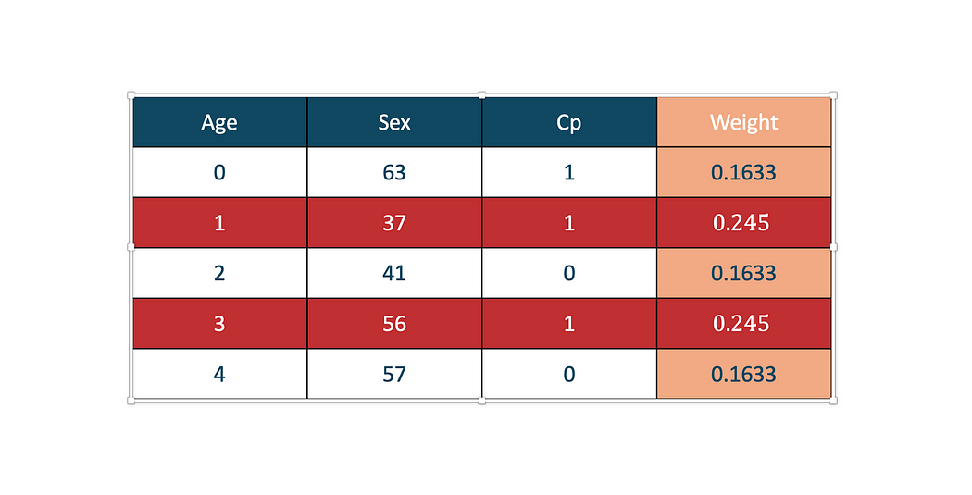
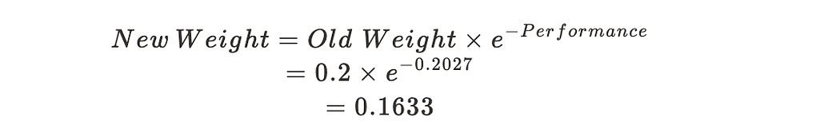
Lets see an example:
Correctly predicted observation
Lets see an example:
As you can see, the value of the new weight is increased from 0.2 to 0.245
The reason is to increase the weight for the incorrectly predicted observation so that they can be passed to the next base learner.

Slide 26
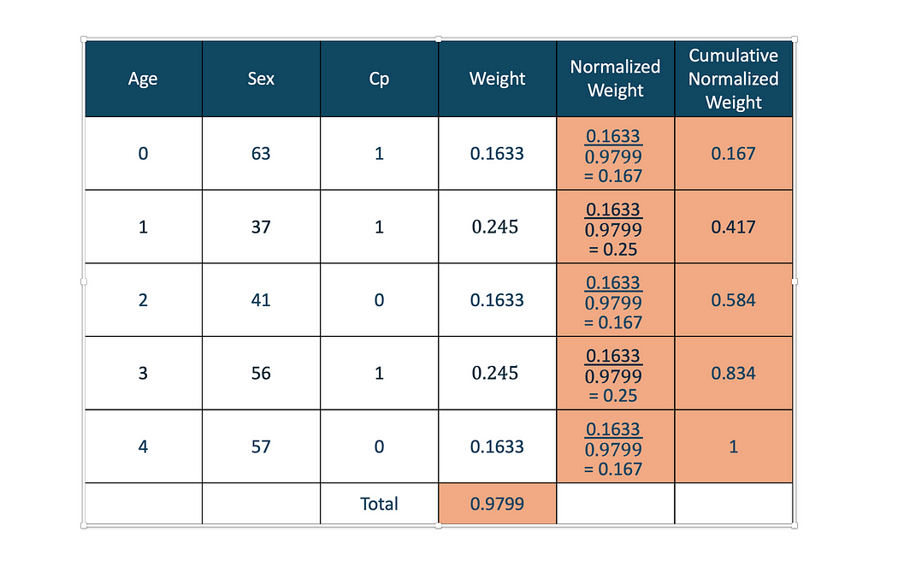
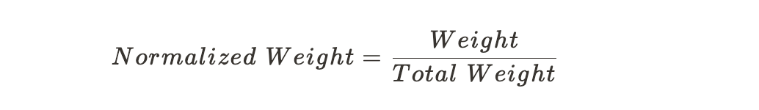
5. Now, we have to find a Normalized Weight to ensure the total weight is equal to 1. Then, we calculate the Cumulative Normalized Weight
As you can see in the table above, Normalized weight is calculated by
and Cumulative Normalized weight is just adding the normalized weight.
The idea behind creating the Cumulative Normalized weight is to create different Bins.
From the above table, we can see that we have five bins

Slide 27
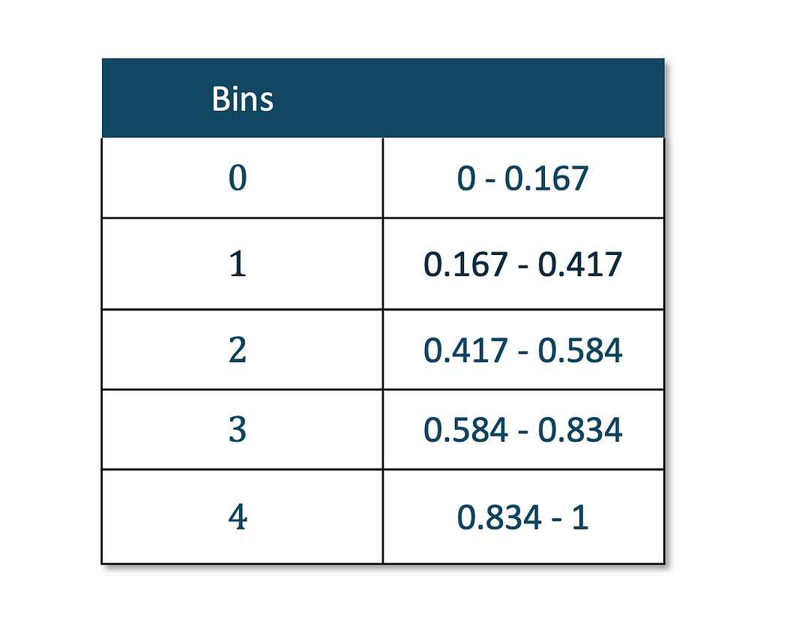
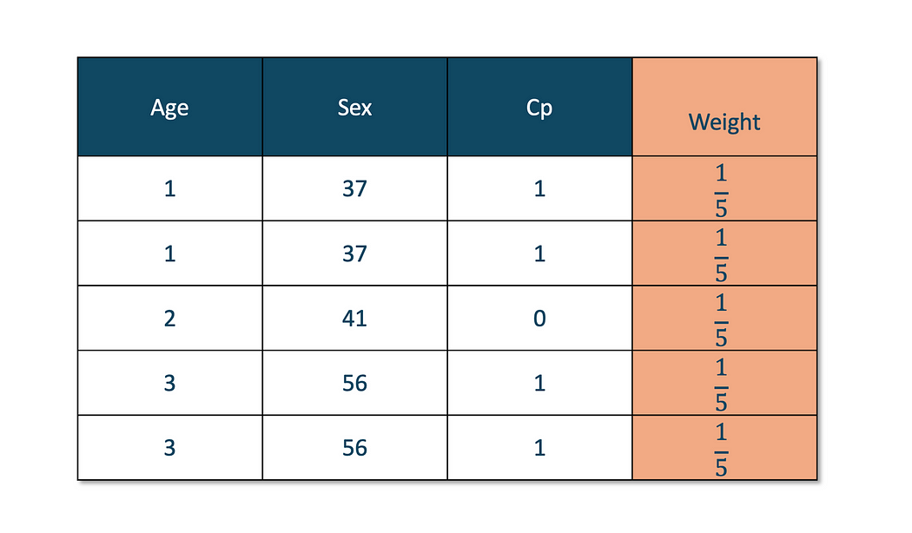
According to this bin list, a New Dataset is created that the next Base Learner can use.
6. Creating a New Dataset
This is where it gets interesting. To create a new dataset, we find random values between 0 and 1. The total number of random values should be equal to the total number of observations.
We have 5 observations, so we will choose five random values. Let’s say they are,
[0.25,0.4.0.5,0.35,0.82]
Most of the time, the incorrectly classified observation will be selected after creating the bins. Since the bins that contain incorrectly predicted observations have a larger range, the probability of it being selected is higher.
Now, we see where all those values fall in.
After looking at the bins table, We get these values [1,1,2,1,3]
Now our new dataset will be:
Based on this data, we will repeat the process and proceed with Next Base Learner.
The final prediction is obtained by aggregating the predictions of all weak classifiers based on their weights.

Slide 28
Gradient Boosting - Pros and Cons
Pros:
Highly accurate due to sequential correction of errors.
Can handle complex datasets and interactions between features.
Works well with small to medium-sized datasets.
Cons:
Prone to overfitting if not tuned properly.
Slower to train compared to random forests.
Difficult to interpret (less interpretable than individual decision trees).

Slide 29
Hyperparameters of Gradientboost
n_estimators (Number of Trees):
Number of boosting iterations (trees).
More trees improve performance but may cause overfitting.
learning_rate (Shrinkage):
Step size for updating predictions in each boosting iteration.
Lower values make learning slower but require more trees.
max_depth:
Maximum depth of each tree.
Controls model complexity; deeper trees can overfit.
min_samples_split / min_child_samples:
Minimum number of samples required to split an internal node.
Higher values prevent overfitting.
min_samples_leaf:
Minimum number of samples in a leaf node.
Ensures leaf nodes are not too small.
Subsample:
Fraction of samples used to grow each tree.
Reduces overfitting; common range: 0.5–1.0.
colsample_bytree:
Fraction of features used for building each tree.
Helps in regularization and reduces computation.

Slide 30
Impact of Hyperparameters in Gradient Boosting
1. learning_rate
learning_rate controls the contribution of each tree to the final model.
Smaller rates:
Pros: Higher accuracy with more iterations.
Cons: Slower training and longer computation time.
Example:
Rate 0.1: High accuracy with sufficient iterations.
Rate 0.5: Faster training but risks lower accuracy.
2. n_estimators
n_estimators determines the number of boosting stages (trees) to fit.
Increasing n_estimators:
Pros: Improves accuracy by reducing bias.
Cons: Longer training time and risk of overfitting if not regularized.
Example:
100 trees: Good trade-off between accuracy and computation.
500 trees: Slightly higher accuracy but slower training.
3. max_depth
max_depth sets the maximum depth of each tree.
Increasing max_depth:
Pros: Captures more complex patterns in the data.
Cons: Higher risk of overfitting with complex models.
Example:
Depth 3: Balances accuracy and generalization.
Depth 10: May overfit, especially on small datasets.

Slide 31
4. subsample
subsample specifies the fraction of samples used for fitting each tree.
Decreasing subsample:
Pros: Reduces overfitting by adding randomness.
Cons: May lower accuracy if too small.
Example:
subsample = 0.8: Good balance of accuracy and regularization.
subsample = 0.5: Helps prevent overfitting but risks underfitting.
5. min_samples_split
min_samples_split is the minimum number of samples required to split a node.
Increasing min_samples_split:
Pros: Promotes generalization by avoiding splits with few samples.
Cons: Risks underfitting if meaningful splits are ignored.
Example:
min_samples_split = 2: Captures finer splits but may overfit.
min_samples_split = 10: Prevents overfitting, with a risk of underfitting

Slide 32
Comparison - Decision Trees, Random Forest, and Gradient Boosting
*Model* | *Pros* | *Cons* | *Best Use Cases*
Decision Trees | Simple, Interpretable | Overfitting, unstable | Small datasets, interpretable tasks
Random Forest | Reduces overfitting, robust | Computationally expensive, less interpretable | Large datasets, high-dimensional data
Gradient Boosting | High accuracy, effective with complex data | Slow training, Hard to tune | Complex datasets, competitive models

Slide 33
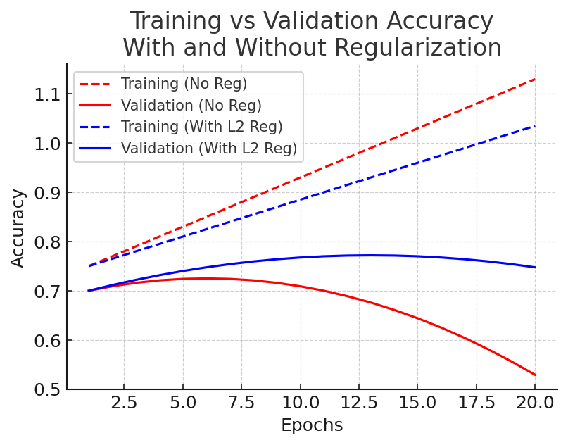
Practical Recommendations
Regularization
Regularization prevents overfitting by controlling model complexity.
Techniques:
Decision Trees: max_depth, min_samples_split, min_samples_leaf.
Random Forests: max_features, limiting tree depth.
Gradient Boosting: learning_rate, subsample, regularization parameters
(L1/L2).
Example:
Without regularization: High accuracy on training but poor generalization.
With regularization: Balanced performance across datasets.
Decision Trees:
Use depth between 3–7 to balance accuracy.
Random Forests:
Use 50–100 trees for stability.
Gradient Boosting:
Start with a learning_rate of 0.1 and tune further.
Perform grid search or randomized search for tuning.

Slide 34

Thank you

